Slide 1

Module 3: Individual Peacekeeping Personnel
Lesson
3.5
Environment and Natural Resources

Slide 2

Relevance
Environment has impact on us, we have impact on environment
Health and well-being, cost savings for the mission
UN Core Pre-Deployment Training Materials 2017

Slide 3
Learning Outcomes
Learners will:
Define “environment” and “do no harm” principle
Explain why it is important to consider, manage and protect environment and natural resources
List the 4Rs as actions to protect the environment
UN Core Pre-Deployment Training Materials 2017

Slide 4
Lesson Overview
Definitions
“Do No Harm” Principle
Importance of Protecting the Environment & Natural Resources
Directives & Policies
Roles & Responsibilities
What Individual Peacekeeping Personnel Can Do
UN Core Pre-Deployment Training Materials 2017

Slide 5
Learning Activity
3.5.1
Film: Beyond Scarcity
Instructions:
List ways water is important in our lives
What happens when there is not enough water?
Why is it important to manage the use of natural resources such as water?
Time: 10 minutes
Film: 5:20 minutes
Discussion: 3 minutes
https://www.youtube.com/watch?v=3jYr8MFTXrM
UN Core Pre-Deployment Training Materials 2017

Slide 6
1. Definitions
Environment: our physical surroundings, including climate, geography, geology, natural resources, wildlife, humans and the inter-relations
Natural resources: actual or potential sources of basic sustenance, wealth and well-being, such as water, air, soil, land, timber, minerals, etc. – can be renewable or non-renewable
Cultural resources: cultural heritage – can be tangible or intangible
UN Core Pre-Deployment Training Materials 2017
Notes:
Would consider animation to show definitions after each click.

Slide 7
2. “Do No Harm” Principle
UN Core Pre-Deployment Training Materials 2017

Slide 8
Learning Activity
3.5.2
Environmental Impacts
Instructions:
Consider: water, energy, solid and hazardous waste, wastewater, wildlife, historical and cultural resources
Discuss the impact the mission can have on these
Time: 5 minutes
Brainstorming: 3 minutes
Discussion: 2 minutes
UN Core Pre-Deployment Training Materials 2017
Notes:
CPTM 3.5.2

Slide 9
3. Importance of Protecting the Environment & Natural Resources
Fragile environments, scarce natural resources
Helps keep the peace
Upholds UN reputation
More effective, efficient missions
Part of your work
UN Core Pre-Deployment Training Materials 2017
Notes:
Should this be green (subheading)?

Slide 10
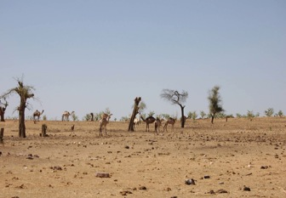
Fragile Environments, Scarce Resources
Post-conflict situations with fragile environments and scarce natural resources – water, land
Common problems – deforestation, competition for fertile land, poor access to clean water
Africa, Middle East – low water availability
Serious environmental, cultural impacts may be a direct result of armed conflict
Diminished local capacity
UN Core Pre-Deployment Training Materials 2017
Notes:
Should this be green (subheading)?

Slide 11
Helps Keep the Peace
  Conflicts fuelled by revenues from natural resources, control of scarce resources
  Marginalization and environmental damage
More systematic mandates on UNPKO role
From 1948 to 2016, 19 UNPKOs mandated
Environmental cooperation for peacebuilding
UN Core Pre-Deployment Training Materials 2017
Notes:
Should this be green (subheading)?

Slide 12
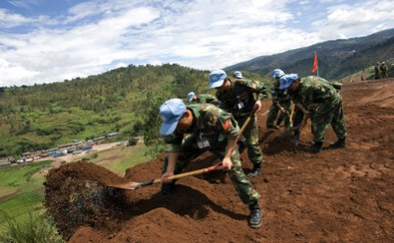
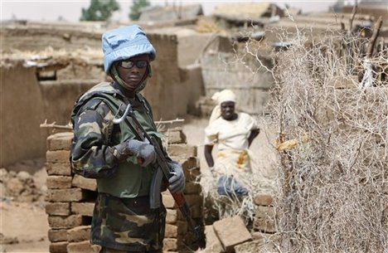
Upholds UN Reputation
Action, inaction – affect public perception and acceptance of mission
UN reputation as a partner for peace leads to better relations
UN Core Pre-Deployment Training Materials 2017
Notes:
Should this be green (subheading)?

Slide 13

More Effective, Efficient Missions
Benefits of reducing the environmental impact – financial savings, health, safety and security
Raises operational excellence
UN Core Pre-Deployment Training Materials 2017
Notes:
Should this be green (subheading)?

Slide 14


Part of Your Work
Walk the talk, lead by example
UN peacekeeping – part of “greening the blue”
UN Core Pre-Deployment Training Materials 2017
Notes:
Should this be green (subheading)?

Slide 15
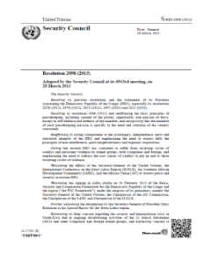
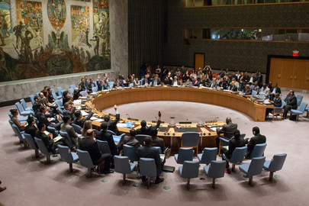


4. Directives & Policies
Security Council Presidential Statement (2007)
Chief Executives Board Decision (2007)
Global Field Support Strategy (2010)
Secretary-General Call for UN Climate Neutrality by 2020
Sustainable Development Goals (SDGs)
Environmental Policy for UN Field Missions (2009)
DPKO-DFS Waste Management for UN Field Missions (2015)
UN Core Pre-Deployment Training Materials 2017
Notes:
Replace pic of SG

Slide 16

5. Roles & Responsibilities
Each field mission should establish environmental policy, objectives, control measures
Specific responsibilities lie with mission leadership and key mission personnel
You are also responsible – you must reflect in your conduct
UN Core Pre-Deployment Training Materials 2017

Slide 17
6. What Individual Peacekeeping Personnel Can Do
Reduce
Reuse
Recycle
Recover
UN Core Pre-Deployment Training Materials 2017

Slide 18

Reduce
Reuse
Recycle
Recover
“Reduce” or “Conserve”
Conserve water
Reduce waste
“Turn it off” for conserving fuel and energy
Conserve energy – “turn it off” and set cooling and heating temperatures at practical levels
UN Core Pre-Deployment Training Materials 2017

Slide 19
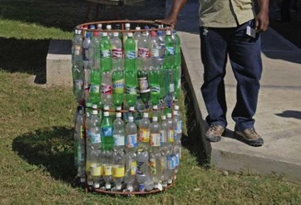
Reduce
Reuse
Recycle
Recover
“Reuse”
Reuse paper
Use reusable bags, batteries, etc.
Reuse water bottles
Many items called “waste” can be a resource – such as tires for soil retention walls
UN Core Pre-Deployment Training Materials 2017

Slide 20
Reduce
Reuse
Recycle
Recover
“Recycle”
Recycle – recycling bins in mission
Segregate waste – e.g. hazard waste
Reduce waste generation as first measure
Make use of Waste Water Treatment Plants to implement water recycling and use
Compost systems – cooking and food scraps for fertilizer
UN Core Pre-Deployment Training Materials 2017

Slide 21
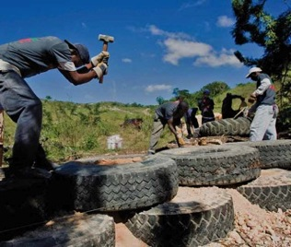
Reduce
Reuse
Recycle
Recover
“Recover”
Recover materials or energy from
waste which cannot be reduced,
reused or recycled
UN Core Pre-Deployment Training Materials 2017

Slide 22
Learning Activity
3.5.3
Practices, Actions, Responsibilities
Instructions:
Consider the images
What are the harmful practices and negative impacts?
What are the good practices?
What changes or solutions would you suggest?
Time: 10 minutes
Group work: 5-7 minutes
Discussion: 3 minutes
UN Core Pre-Deployment Training Materials 2017
Notes:
CPTM 3.5.1

Slide 23
Summary of Key Messages
“Do no harm” – show respect for environment
Protect environment and natural resources – fragile and scarce, keeps peace, upholds UN reputation, mission effectiveness, your job
Take action – reduce, reuse, recycle, recover
UN Core Pre-Deployment Training Materials 2017

Slide 24
Questions
UN Core Pre-Deployment Training Materials 2017

Slide 25
Learning Activity
Learning Evaluation
UN Core Pre-Deployment Training Materials 2017

